Slide 1
第3章：序列比对(Alignment)
比对的数学问题
Pairwise比对
Multiple比对
部分Slides修改自Indiana University汤海旭(Haixu Tang)2007年课程 “Biological sequence analysis”课件。

Slide 2
比对的数学模型
设有序列: X=(x₁,x₂,☹,x_{m})与Y=(y₁,y₂,☹,y_{n}), 长度分别为 m 和 n. 现在要找出最优的全局比对方案，即在 X 与 Y 中分别加入若干插入, 使得符合得最好。
问题：好的度量(比对好的标准)与表达式；好的算法。
X=ATGTTAT, Y=ATCGTAC
A T - G T T A T
A T C G T - A C

Slide 3
Scoring a Pairwise Alignment
Mismatches are penalized by –μ, indels are penalized by –σ, and matches are rewarded with +1, the resulting score is:
#matches – μ(#mismatches) – σ (#indels)
A T - G T T A T
A T C G T - A C
5- μ -2σ

Slide 4
Scoring Matrices
Amino acid substitution matrices
PAM
BLOSUM
DNA substitution matrices
DNA is less conserved than protein sequences
Less effective to compare coding regions at nucleotide level

Slide 5
Affine Gap Penalties
In nature, a series of k indels often come as a single event rather than a series of k single nucleotide events:
ATA__GC
ATATTGC
ATAG_GC
AT_GTGC
Normal scoring would give the same score for both alignments
This is more likely.
This is less likely.

Slide 6
Accounting for Gaps
Gaps- contiguous sequence of spaces in one of the rows
Score for a gap of length x is:
-[ρ + σ(x-1)]
where ρ >0 is the penalty for introducing a gap:
gap opening penalty
ρ will be large relative to σ:
gap extension penalty
because you do not want to add too much of a penalty for extending the gap.

Slide 7
Part I
Pairwise Alignment

Slide 8
Global Alignment Needleman-Wunsch 算法
设有序列: X=(x₁,x₂,☹,x_{m}) 与Y=(y₁,y₂,☹,y_{n}) ,长度分别为 m 和 n , 现要找出最优的全局比对方案,使得对在给定的打分函数下得到最高分。
例：X=“ACGAA” Y=“AACAGAC”
打分策略为每个正确匹配加 1 分
每个配错位置减 1 分，每个插入位置减 1 分。

Slide 9
递推变量
设矩阵F=(F(i,j)) 为 X, Y 的子序列 X_{1,i}和 Y_{1,j} 的最佳比对得分,其中X_{1,i}=(x₁,x₂,☹,x_{i}), Y_{1,j}=(y₁,y₂,☹,y_{j}), 在我们的例子里F(2,3) 就是
的最佳比对得分。
我们可以用递推的方法把 F 求出来, 而F(m,n) 和与F(m,n) 相对应的比对方案正是我们想要的结果。

Slide 10
递推算法
我们可以根据 F(i-1,j),F(i-1,j-1),F(i,j-1)算出 F(i,j)。因为到达(i,j)的路径必经(i-1,j-1),(i,j-1),(i-1,j)三者之一，因而到达(i,j)的最佳路径必为到达它们三者之一的最佳路径再加上最后一步的分值中最优的路径.

Slide 11
递推演示
 | Y | A | A | C | A | G | A | C
X | 0 | -1 | -2 | -3 | -4 | -5 | -6 | -7
A | -1
C | -2
G | -3
A | -4
A | -5
1
-2
-2

Slide 12
递推演示
Y
A
A
C
A
G
A
C
X
0
-1
-2
-3
-4
-5
-6
-7
A
-1
1
C
-2
G
-3
A
-4
A
-5

Slide 13
递推演示
Y
A
A
C
A
G
A
C
X
0
-1
-2
-3
-4
-5
-6
-7
A
-1
1
0
C
-2
0
G
-3
A
-4
A
-5

Slide 14
递推演示
Y
A
A
C
A
G
A
C
X
0
-1
-2
-3
-4
-5
-6
-7
A
-1
1
0
-1
C
-2
0
0
G
-3
-1
A
-4
A
-5

Slide 15
递推演示
Y
A
A
C
A
G
A
C
X
0
-1
-2
-3
-4
-5
-6
-7
A
-1
1
0
-1
-2
C
-2
0
0
1
G
-3
-1
-1
A
-4
-2
A
-5

Slide 16
递推演示
Y
A
A
C
A
G
A
C
X
0
-1
-2
-3
-4
-5
-6
-7
A
-1
1
0
-1
-2
-3
-4
-5
C
-2
0
0
1
0
-1
-2
-3
G
-3
-1
-1
0
0
1
0
-1
A
-4
-2
0
-1
1
0
2
1
A
-5
-3
-1
-1
0
0
1
1

Slide 17
Y
A
A
C
A
G
A
C
X
0
-1
-2
-3
-4
-5
-6
-7
A
-1
1
0
-1
-2
-3
-4
-5
C
-2
0
0
1
0
-1
-2
-3
G
-3
-1
-1
0
0
1
0
-1
A
-4
-2
0
-1
1
0
2
1
A
-5
-3
-1
-1
0
0
1
1
X | -- | A | C | -- | G | A | A
Y | A | A | C | A | G | A | C
X | A | -- | C | -- | G | A | A
Y | A | A | C | A | G | A | C

Slide 18
仿射罚分下的比对
罚分函数:
仍然可以采用动态规划算法，其核心是：只要记住最后的位置是否有过空格，就可以决定如何打分

Slide 19
仿射罚分下的比对
迭代算法

Slide 20
局部比对(Local Alignment)
两个序列的局部比对，是指在两个序列中分别找出一段子序列，使得它们的全局比对符合度最高。
局部比对的算法与全局比对有两点不同：
局部比对比全局比对又增加了两个选择参数:序列的位置和长度,因而
- F(i,j)的初始化和递推公式不同;
- 回溯开始位置不同。

Slide 21
Smith-Waterman 算法
初始化：F(i, 0) 和F(0, j) 均为零
递推公式：

Slide 22
Smith-Waterman 算法（II）
四者之间的最大者，多了一个取零的可能。取零意味着从当前位置开始一个新的比对,也就是说若比对到某处分数为负，那就索性从头开始新的比对.
X | -- | A | C | -- | G | A | A
Y | A | A | C | A | G | A | C

Slide 23
回溯
Y
A
A
C
A
G
A
C
X
0
0
0
0
0
0
0
0
A
0
1
1
0
1
0
1
0
C
0
0
0
2
1
0
0
2
G
0
0
0
1
1
2
1
1
A
0
1
1
0
2
1
3
2
A
0
1
2
1
1
1
2
2
回溯时,由于局部比对可能到任何位置结束，我们从整个矩阵中找到最大值，从整个矩阵中最大值处开始回溯到0为止。

Slide 24
局部比对演示
于是得到最佳局部比对
X | A | A | C | A | G | A | C
Y |  | A | C | --- | G | A | A

Slide 25
Representing Sequence Alignment Using Pair HMM
“Hidden” States
Match (M)
Insertion in x (X)
insertion in y (Y)
Observation Symbols
Match (M): {(a,b)| a,b in ∑ }.
Insertion in x (X): {(a,-)| a in ∑ }.
Insertion in y (Y): {(-,a)| a in ∑ }.

Slide 26
Representing Sequence Alignment Using Pair HMM
1-ε
ε
Emission probabilities:
M: P_{xi,yj}
X: q_{xi}
Y: q_{yj}
X
δ
1-2δ
M
δ
ε
Y
1-ε

Slide 27
Alignment
w
A
T
C
G
T
A
C
v
0
1
2
3
4
5
6
7
A T - G T T A T
A T C G T - A C
M M Y M M X M M
A
0
T
1
G
2
T
3
4
T
5
A
Path= hidden state sequence
6
T
7

Slide 28
Sequence Alignment Using Pair HMM
Based on the HMM, each alignment of two DNA/protein sequences can be assigned with a probability score;
Each “observation symbol” of the HMM is an aligned pair of two letters, or of a letter and a gap.
The Markov chain of hidden states should represent a scoring scheme reflecting an evolutionary model.
Transition and emission probabilities define the probability of each aligned pair of sequences.
Given two input sequences, we look for an alignment of these two sequences of maximum probability.

Slide 29
Transitions and Emission Probabilities
M
X
Y
Transitions probabilities
(note the forbidden ones).
δ = probability for 1st gap
ε = probability for extending gap.
1-2δ
δ
δ
M
1- ε
ε
0
X
1- ε
0
ε
Y
Emission Probabilities
Match: (a,b) with p_{ab} – only from M states
Insertion in x: (a,-) with q_{a} – only from X state
Insertion in y: (-,a).with q_{a} - only from Y state.

Slide 30
Scoring Alignments
For each pair of sequences x (of length m) and y (of length n), there are many alignments of x and y, each corresponds to a different state sequence (with the length between max{m,n} and m+n).
Given the transmission and emission probabilities, each alignment has a defined score – the product of the corresponding probabilities.
An alignment is “most probable”, if it maximizes this score.

Slide 31
Finding the Most Probable Alignment-Viterbi Algorithm
Let v^{M}(i,j) be the probability of the most probable alignment of x(1..i) and y(1..j), which ends with a match (state M). Similarly, v^{X}(i,j) and v^{Y}(i,j), the probabilities of the most probable alignment of x(1..i) and y(1..j), which ends with states X or Y, respectively.

Slide 32
Most Probable Alignment
Similar argument for v^{X}(i,j) and v^{Y}(i,j), the probabilities of the most probable alignment of x(1..i) and y(1..j), which ends with an insertion to x or y, are:

Slide 33
Adding Termination Probabilities
The last transition in each alignment is to the END state, with probability τ
 | M | X | Y | END
M | 1-2δ -τ | δ | δ | τ
X | 1-ε -τ | ε |  | τ
Y | 1-ε -τ |  | ε | τ
END |  |  |  | 1
For this, an END state is added, with transition probability τ from any other state to END. This assumes expected sequence length of 1/ τ.

Slide 34
Full Pair HMM Model
τ
δ
1-ε
ε
X
1-τ-2δ
δ
δ
1-2δ
M
δ
δ
End
Begin
ε
Y
δ
1-ε

Slide 35
The log-odds Scoring Function
We wish to know if the alignment score is above or below the score of random alignment of sequences with the same length.
Model comparison
We need to model random sequence alignment by HMM, with end state. This model assigns probability to each pair of sequences x and y of arbitrary lengths m and n.

Slide 36
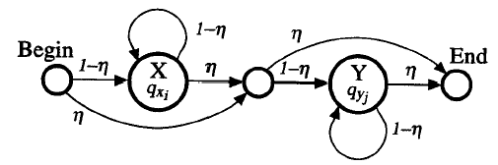
HMM for Random Sequence Alignment

Slide 37
HMM for a Random Sequence Alignment
The transition probabilities for the random model, with termination probability η:
(x is the start state)
 |  | X | Y | END
X | 1- η |  | η | 0
Y | 0 |  | 1- η | η
END | 0 |  | 0 | 1
The emission probability for a is q_{a.} Thus the probability of x (of length n) and y (of length m) being random is:
And the corresponding score is:

Slide 38
Markov Chains for “Random” and “Model”
 | M | X | Y | END
M | 1-2δ -τ | δ | δ | τ
X | 1-ε -τ | ε |  | τ
Y | 1-ε -τ |  | ε | τ
END |  |  |  | 1
“Random”
 | X | Y | END
X | 1- η | η
Y |  | 1- η | η
END |  |  | 1
“Model”

Slide 39
Combining Models in the Log-odds Scoring Function
In order to compare the M score to the R score of sequences x and y, we can find an optimal M score, and then subtract from it the R score.
This is insufficient when we look for local alignments, where the optimal substrings in the alignment are not known in advance. A better way:
Define a log-odds scoring function which keeps track of the difference Match-Random scores of the partial strings during the alignment.
At the end add to the score (logτ – 2logη) to compensate for the end transitions in both models.

Slide 40
The Log-odds Scoring Function
And at the end add to the score (logτ – 2logη).

Slide 41
对应关系
对比前面的仿射罚分下的动态规划算法，令

Slide 42
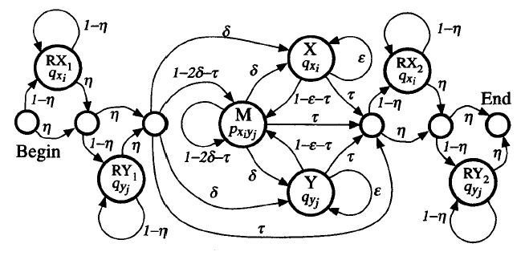
A Pair HMM For Local Alignment

Slide 43
Full Probability Of The Two Sequences
HMMs allow for calculating the probability that a given pair of sequences are related according to the HMM by any alignment
This is achieved by summing over all alignments

Slide 44
Full Probability Of The Two Sequences
The way to calculate the sum is by using the forward algorithm
f^{k}(i,j) : the combined probability of all alignments up to (i,j) that end in state k

Slide 45
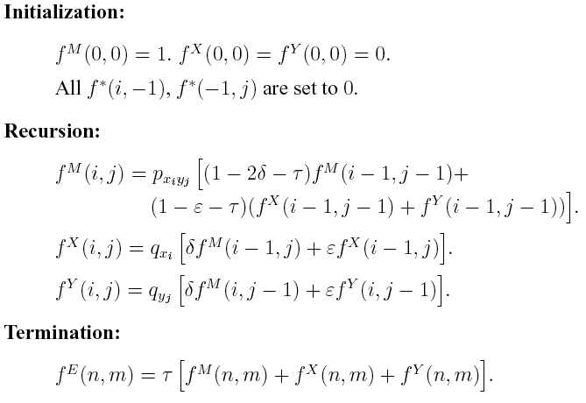
Forward Algorithm For Pair HMMs
P(x,y)

Slide 46
Full Probability Of The Two Sequences
P(x,y) gives the likelihood that x and y are related by some unspecified alignment, as opposed to being unrelated
If there is an unambiguous best alignment, P(x,y) will be “dominated” by the single hidden state seuence corresponding to that alignment

Slide 47
How Correct is the Alignment
Define a posterior distribution P(s|x,y) over all alignments given a pair of sequences x and y
Probability that the optimal scoring alignment is correct:
Viterbi algorithm
Forward algorithm

Slide 48
Usually the probability that the optimal scoring alignment is correct, is extremely small!
Reason: there are many small variants of the best alignment that have nearly the same score.

Slide 49
The Posterior Probability That Two Residues Are Aligned
If the probability of any single complete path being entirely correct is small, can we say something about the local accuracy of an alignment?
It is useful to be able to give a reliability measure for each part of an alignment

Slide 50
The posterior probability that two residues are aligned
The idea is:
calculate the probability of all the alignments that pass through a specified matched pair of residues (x_{i},y_{j})
Compare this value with the full probability of all alignments of the pair of sequences
If the ratio is close to 1, then the match is highly reliable
If the ratio is close to 0, then the match is unreliable

Slide 51
The Posterior probability that Two Residues are aligned
Notation: x_{i}◊y_{j} denotes that x_{i} is aligned to y_{j}
We are interested in P(x_{i}◊y_{j}|x,y)
We have
P(x,y) is computed using the forward algorithm
P(x,y,x_{i}◊y_{j}): the first term in computed by the forward algorithm, and the second is computed by the backward algorithm (=b^{M}(i,j) in the backward algorithm)

Slide 52
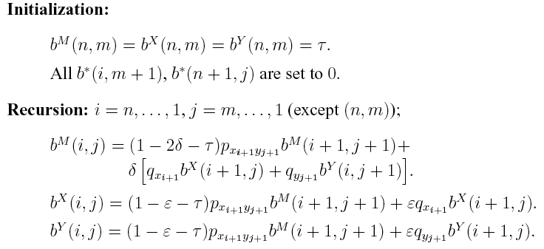
Backward Algorithm For Pair HMMs

Slide 53
Part II
Multiple Alignment

Slide 54
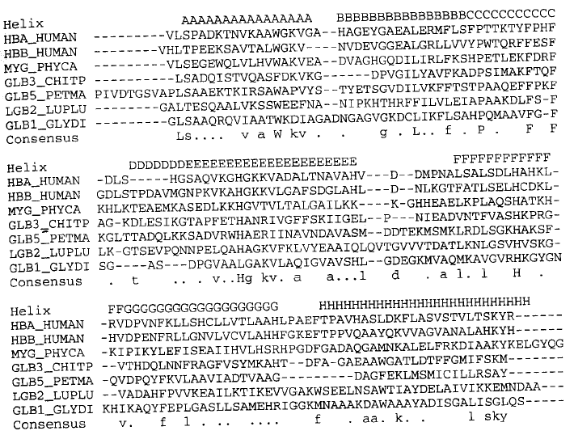
Multiple Sequence Alignment (Globin family)

Slide 55
Profile Model (PSSM)
A natural probabilistic model for a conserved region would be to specify independent probabilities e_{i}(a) of observing nucleotide (amino acid) a in position i
The probability of a new sequence x according to this model is

Slide 56
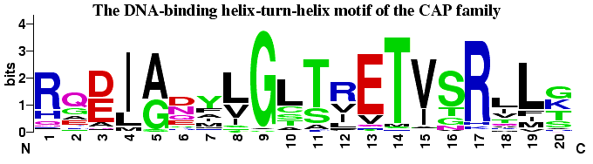
Profile
Position Specific Score Matrix (PSSM)
- A G G C T A T C A C C T G
T A G – C T A C C A - - - G
C A G – C T A C C A - - - G
C A G – C T A T C A C – G G
C A G – C T A T C G C – G G
A 1 1 .8
C .6 1 .4 1 .6 .2
G 1 .2 .2 .4 1
T .2 1 .6 .2
- .2 .8 .4 .8 .4

Slide 57
Searching Profiles: Inference
Give a sequence S of length L, compute the likelihood ratio of being generated from this profile vs. from background model:
R(S|P)=
Searching motifs in a sequence: sliding window approach

Slide 58
Match States for Profile HMMs
Match states
Emission probabilities
Begin
....
M_{j}
....
End

Slide 59
Components of Profile HMMs
Insert states
Emission prob.
Usually back ground distribution q_{a}.
Transition prob.
M_{i} to I_{i}, I_{i} to itself, I_{i} to M_{i+1}
I_{j}
Begin
M_{j}
End

Slide 60
Components of Profile HMMs
Delete states (跳过某些Match State, 而直接过渡到后面的Match State)
No emission prob.
Cost of a deletion
M→D, D→D, D→M
Each D→D might be different
D_{j}
Begin
M_{j}
End

Slide 61
Why “Delete” State？
对序列HBB_HUMAN, 出现了两个“Delete”, 而直接跳到了M4.
避免多个Match状态之间的概率转移，简化模型参数；
HBA_HUMAN ...VGA--HAGEY...
HBB_HUMAN ...V----NVDEV...
MYG_PHYCA ...VEA--DVAGH...
GLB3_CHITP ...VKG------D...
GLB5_PETMA ...VYS--TYETS...
LGB2_LUPLU ...FNA--NIPKH...
GLB1_GLYDI ...IAGADNGAGV...
*** *****

Slide 62
Full Structure of Profile HMMs
D_{j}
I_{j}
Begin
M_{j}
End
注意到D-> I, I-> D这样的转移往往很少发生；
Number of match states 通常取成average sequence length in the family

Slide 63
Deriving HMMs from Multiple Alignments
Key idea behind profile HMMs
Model representing the consensus for the alignment of sequence from the same family
Not the sequence of any particular member
HBA_HUMAN ...VGA--HAGEY...
HBB_HUMAN ...V----NVDEV...
MYG_PHYCA ...VEA--DVAGH...
GLB3_CHITP ...VKG------D...
GLB5_PETMA ...VYS--TYETS...
LGB2_LUPLU ...FNA--NIPKH...
GLB1_GLYDI ...IAGADNGAGV...
*** *****

Slide 64
Deriving HMMs from Multiple Alignments
Basic profile HMM parameterization
Aim: making the higher probability for sequences from the family
Parameters
the probabilities values : trivial if many of independent alignment sequences are given.
length of the model: heuristics or systematic way

Slide 65
Estimation of Prob.
Maximum likelihood (ML) estimation
given observed freq. c_{ja} of residue a in position j.
Simple pseudocounts (Dirichilet Prior)
q_{a}: background distribution
A: weight factor

Slide 66
Searching with Profile HMMs
Main usage of profile HMMs
Detecting potential sequences in a family
Matching a sequence to the profile HMMs
Viterbi algorithm or forward algorithm
Comparing the resulting probability with random model

Slide 67
Searching with Profile HMMs
Viterbi algorithm (optimal log-odd alignment)

Slide 68
Viterbi算法说明
通常取Insert状态下的Emission probability为背景概率分布，因此上面的第二个式子中不Emission项为0;
通常D->I, I->D的状态转移都非常小，第三式子中可能只有D-> M 和M-> D的转移。

Slide 69
Searching with Profile HMMs
Forward algorithm: summing over all potent alignments

Slide 70
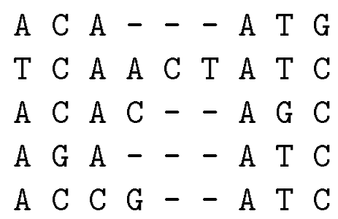
An Example
How could we characterize this (hypothetical) family of nucleotide sequences?
Keep the Multiple Alignment
Try a regular expression
[AT] [CG] [AC] [ACTG]* A [TG] [GC]
But what about?
T G C T - - A G G vrs
A C A C - - A T C
Try a consensus sequence:
A C A - - - A T C
Depends on distance measure
Example borrowed from Salzberg, 1998

Slide 71
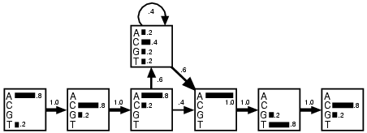
An Example
Emission Probabilities
Transition probabilities

Slide 72
Insert (Loop) States

Slide 73
Optimal Model Construction: Mark Columns
(a) Multiple alignment:
(c) Observed emission/transition counts
x x . . . x
bat A G - - - C
rat A - A G - C
cat A G - A A -
gnat - - A A A C
goat A G - - - C
1 2 . . . 3
0 1 2 3
A - 4 0 0
C - 0 0 4
G - 0 3 0
T - 0 0 0
A 0 0 6 0
C 0 0 0 0
G 0 0 1 0
T 0 0 0 0
M-M 4 3 2 4
M-D 1 1 0 0
M-I 0 0 1 0
I-M 0 0 2 0
I-D 0 0 1 0
I-I 0 0 4 0
D-M - 0 0 1
D-D - 1 0 0
D-I - 0 2 0
match
emissions
insert
emissions
(b) Profile-HMM architecture:
D
D
D
state
transitions
I
I
I
I
beg
M
M
M
end
0
1
2
3
4

Slide 74
Align Sequences to Profile HMM
Align a sequence to a profile HMM→Viterbi algorithm
Construction a multiple alignment just requires calculating a Viterbi alignment for each individual sequence.
Residues aligned to the same match state in the profile HMM should be aligned in the same columns.

Slide 75
Scoring the Simple HMM
#1 - “T G C T - - A G G” vs: #2 - “A C A C - - A T C”
Regular Expression ([AT] [CG] [AC] [ACTG]* A [TG] [GC]):
#1 = Member #2: Member
HMM:
#1 = Score of 0.0023% #2 Score of 4.7% (Probability)
#1 = Score of -0.97 #2 Score of 6.7 (Log odds)
Notes:
Mention NULL model assumes equal chance of each nucleotide in a model of the same length.

Slide 76
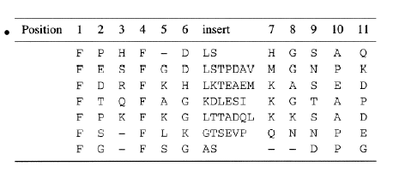
Multiple Alignment with a Known Profile HMM

Slide 77
Profile HMM Training from Unaligned Sequences
Harder problem
estimating both a model and a multiple alignment from initially unaligned sequences.
Initialization: Choose the length of the profile HMM and initialize parameters.
Training: estimate the model using the Baum-Welch algorithm (iteratively).
Multiple Alignment: Align all sequences to the final model using the Viterbi algorithm and build a multiple alignment as described in the previous section.

Slide 78
Profile HMM Training from Unaligned Sequences
Initial Model
The only decision that must be made in choosing an initial structure for Baum-Welch estimation is the length of the model M.
A commonly used rule is to set M be the average length of the training sequence.
We need some randomness in initial parameters to avoid local maxima.

Slide 79
References
S. Durbin, S. Eddy, A. Krogh and G. Mitchison. Biological Sequence Analysis—Probabilistic Models of Proteins and Nucleic Acids. 1998, Cambridge University Press.

